Slide 1
CrystalMaker Workshop
Northwestern MSUS
https://github.com/emeryjdk/MSE-Workshops/tree/master/CrystalMaker%20Workshop
https://tinyurl.com/y52acrpv
August 26, 2020

Slide 2
Welcome First-year Students!
Notes:
Adetoye
Zhang
Ekaputra
Walker
Ramesh
Purwanto Rosenmann
Chery Liu

Slide 3
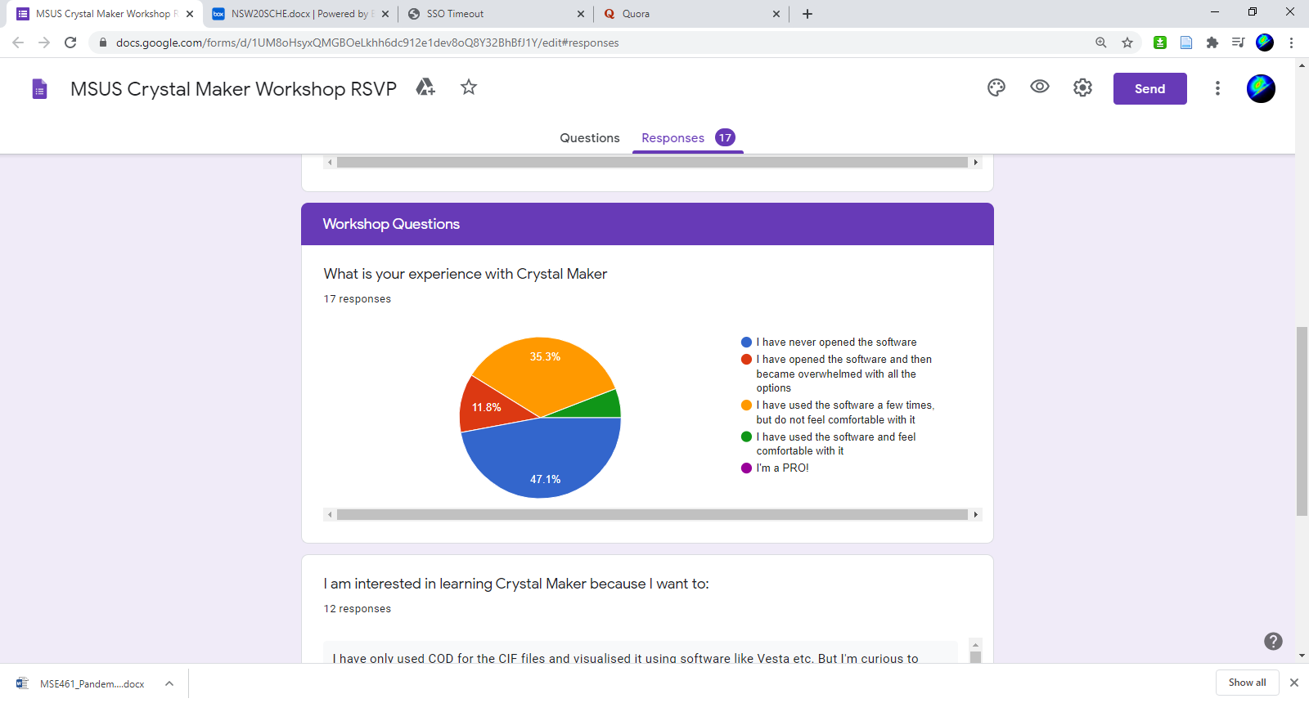
CrystalMaker - Outline
Introduction (10 min)
Building Crystals and Basic Navigation (20 min)
Attendee Figure Competition (5 min)
Diffraction (10)
Powder simulations
Single crystal simulations
Discussion/Consulting (Until close)
Box Link: https://northwestern.app.box.com/s/s63nlkvdtnax6s22okstcj251ajjk8ay

Slide 4
Requests
Better visualization of crystal structures (×6)
Learn more about crystallography (×2)
Make nice figures (×2)
General research tool competency (×2)

Slide 5
CrystalMaker Workshop - Outcomes
Attendees will be able to access CrystalMaker as well as other useful, free software from Northwestern.
Attendees will be able to
Create crystals from scratch
Use a crystallographic datafile to render crystal structures
Attendees will be able to investigate the structural details of atomic/molecular assemblies they may encounter in classes or research.
Attendees will be able to produce publication-quality images.
Attendees will be able to simulate power and single-crystal diffraction patterns.

Slide 6
(Some) Free Competitors
VESTA - https://jp-minerals.org/vesta/en/
Mercury - https://www.ccdc.cam.ac.uk/Community/csd-community/freemercury/
PyXtal* - https://pyxtal.readthedocs.io/en/latest/
J(S)mol - http://jmol.sourceforge.net/
Many more…
Notes:
VESTA – compatibility with DFT data. Electronic structure visualization. Broad import option formats.
Mercury – powerful for visualization (mostly chemistry) and computes simple powder structures.
J(S)mol – Java/JavaScript creation of applets and HTML5 snippets that can be embedded into webpages.
PyXtal – Clean, powerful, opensource Python interface.

Slide 7
CrystalMaker Strengths:
Intuitive GUI
Versatile visualization, rendering, and annotation options
Diffraction calculations
Multi-structure/Interface visualization
[Native to Mac]
Extremely satisfying sound effects

Slide 8
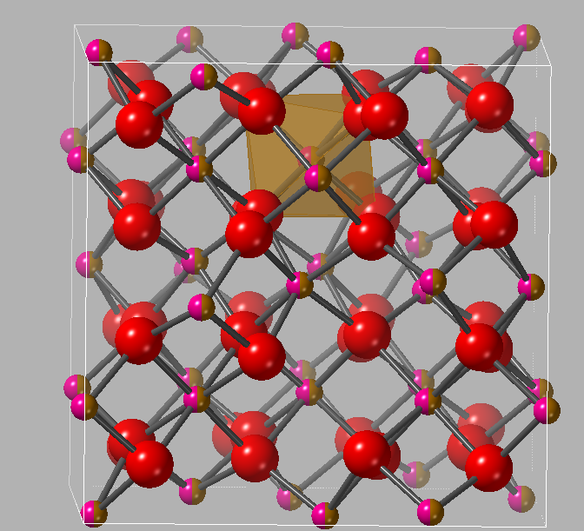
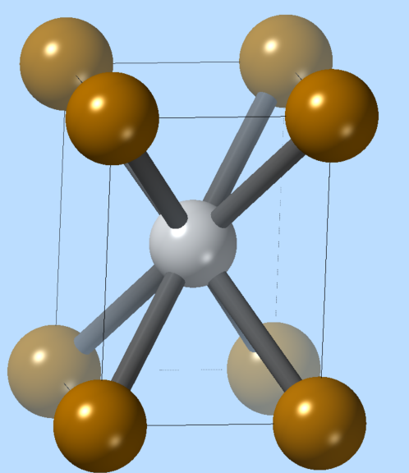
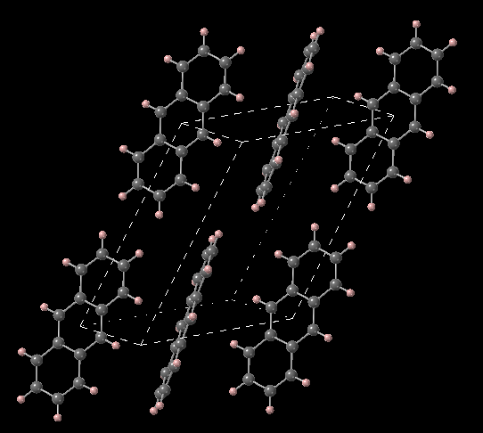
CrystalMaker Gallery
Notes:
Bixbiyite FeMnO3
FeNi
Antracene – wide band gap organic semiconductor

Slide 9
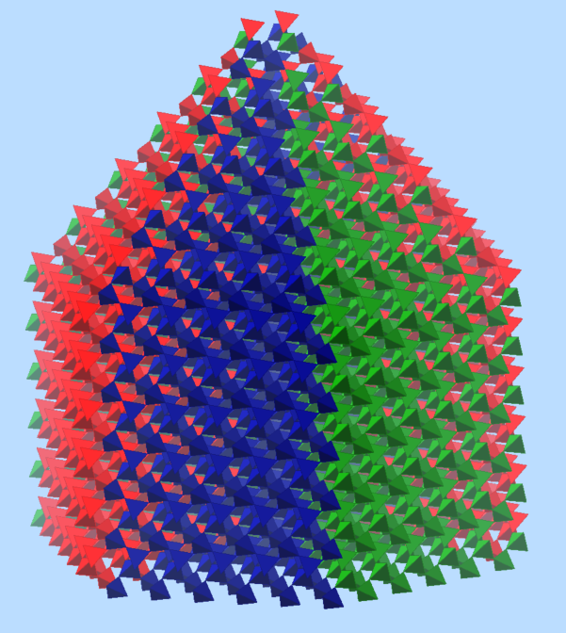
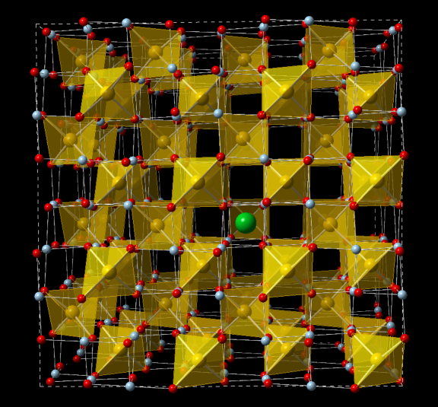
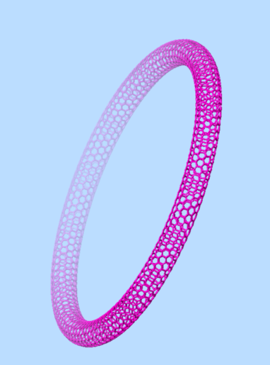
CrystalMaker Gallery
Notes:
Quartz habit
Sr-doped spinel (MgAl₂O₄)
Bucky torus

Slide 10
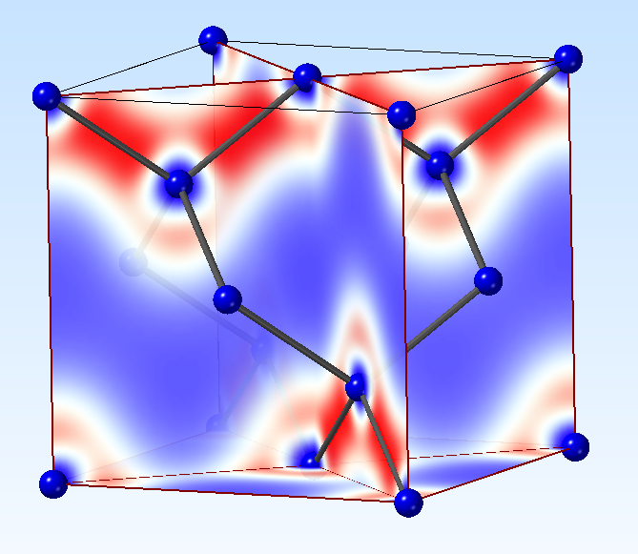
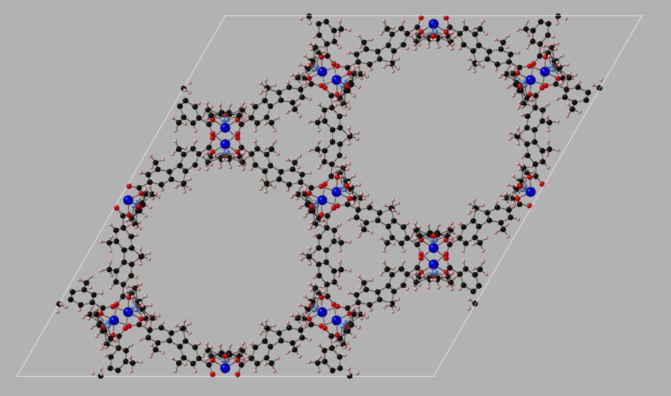
CrystalMaker Gallery
Notes:
Silicon electron density (from VASP) – reason for “bond charge” forbidden reflections: https://onlinelibrary.wiley.com/doi/epdf/10.1002/pssb.19660180118
MOF 602

Slide 11
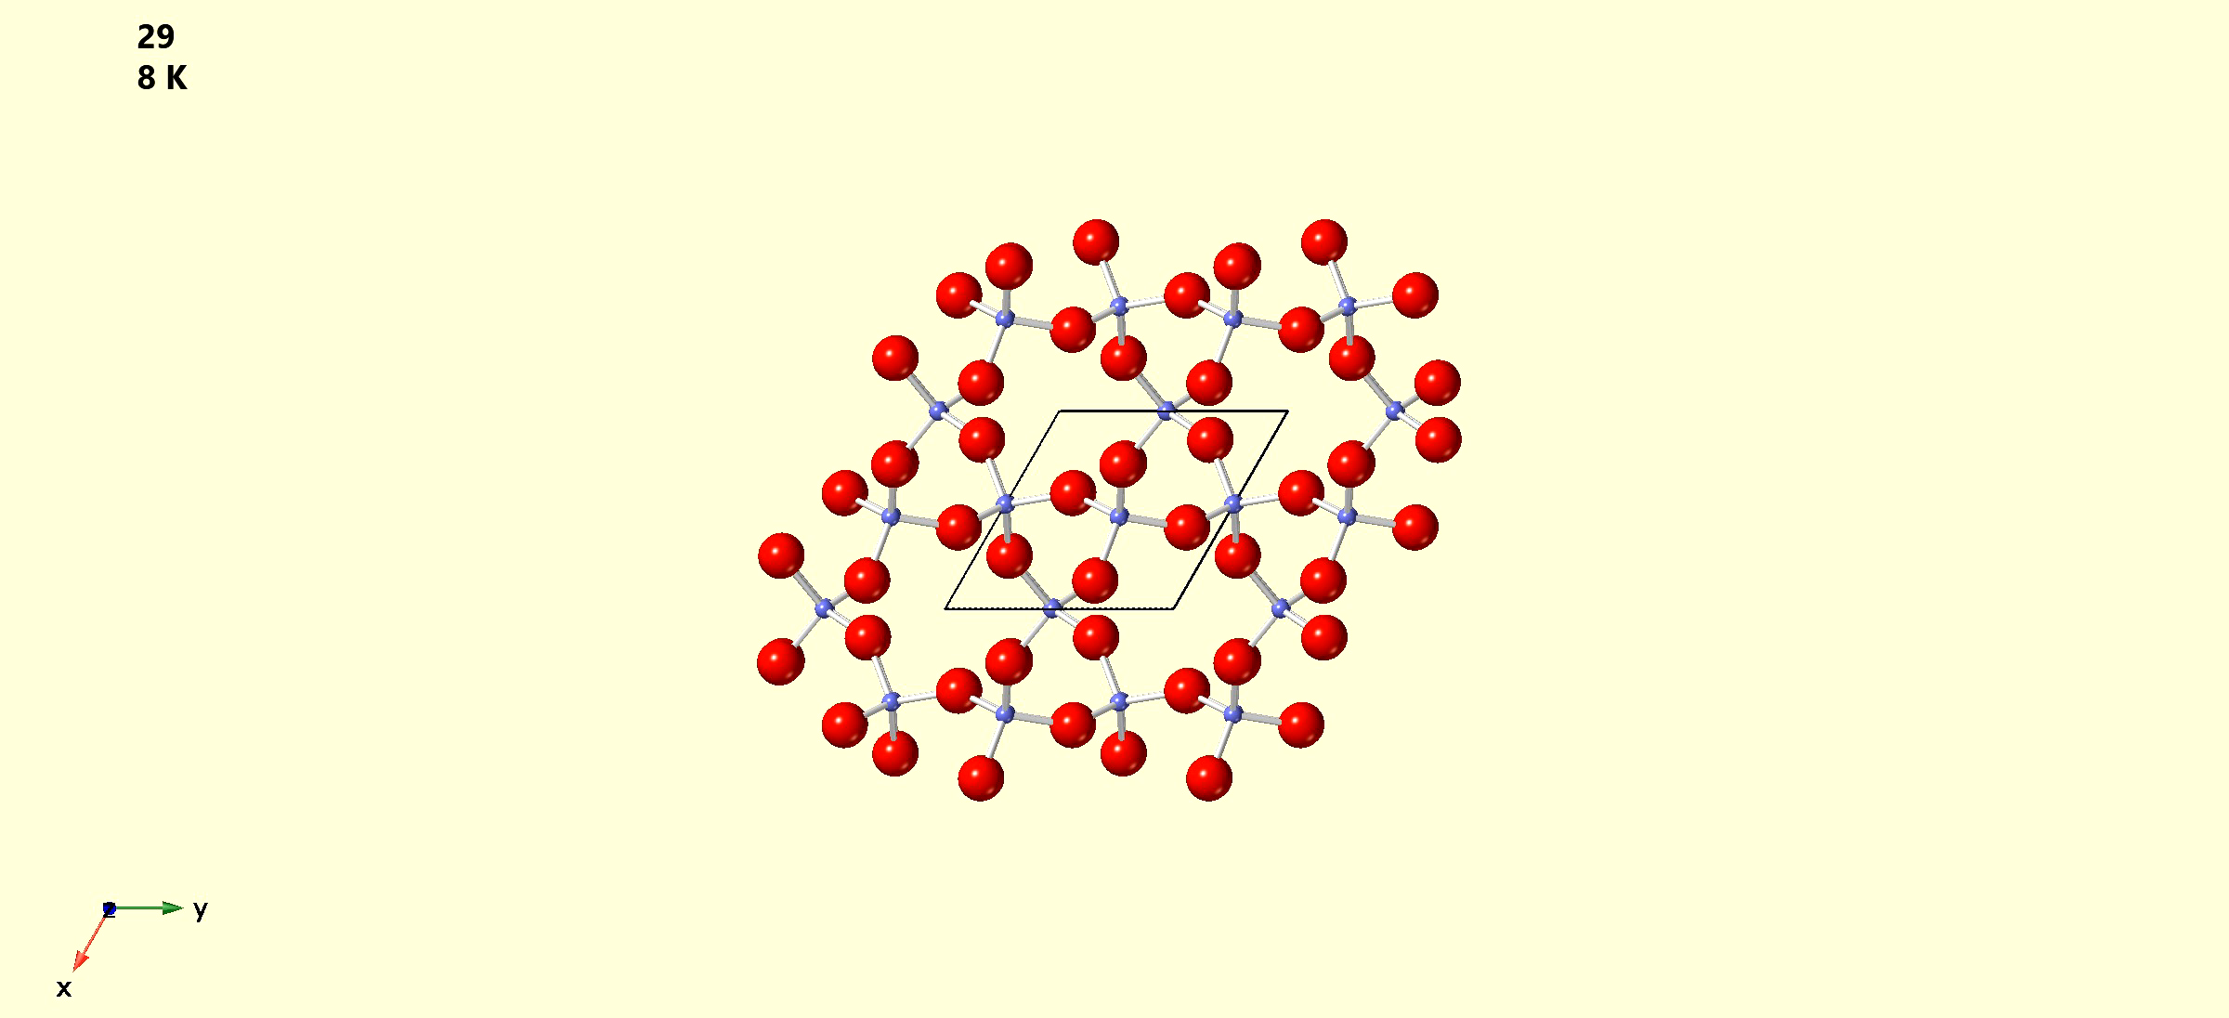
CrystalMaker Gallery
Notes:
Phase transformation of quartz. Which one?

Slide 12
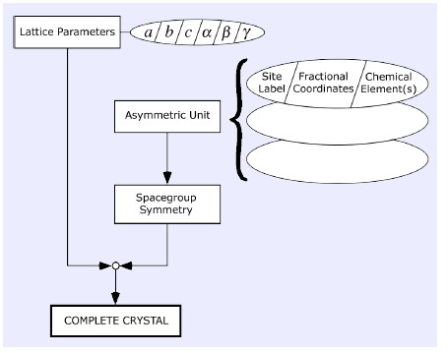
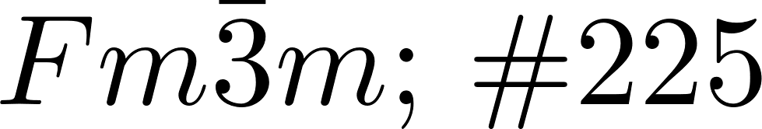
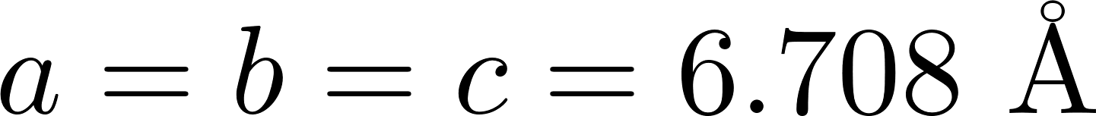
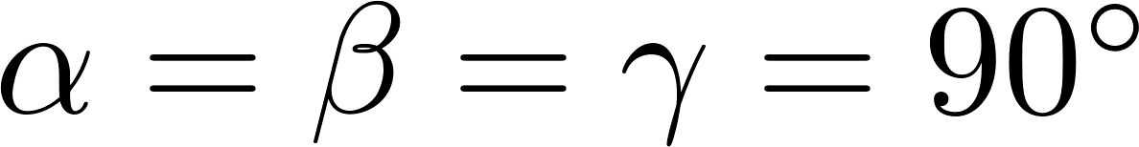
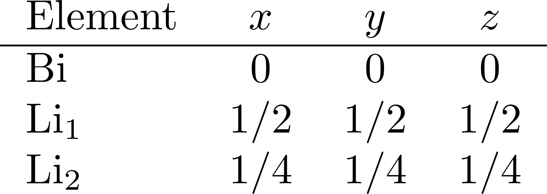
Getting Started
Open CrystalMaker
We’re going to work with Li₃Bi

Slide 13
Interactivity
Think in orthogonal screen axes.
Crystallographic axes will rotate with crystal.

Slide 14
Interactivity
Click and drag to rotate crystal
Shift/“Rotate” click and drag to rotate about screen z-axis
Pinch or mouse wheel to zoom in and out

Slide 15
Create/Upload Your Own Figure
https://docs.google.com/presentation/d/1ezD_qgWEvC8HWrK0ysltxiPbUd8LkMivL_V7CiRktc8/edit?usp=sharing

Slide 16
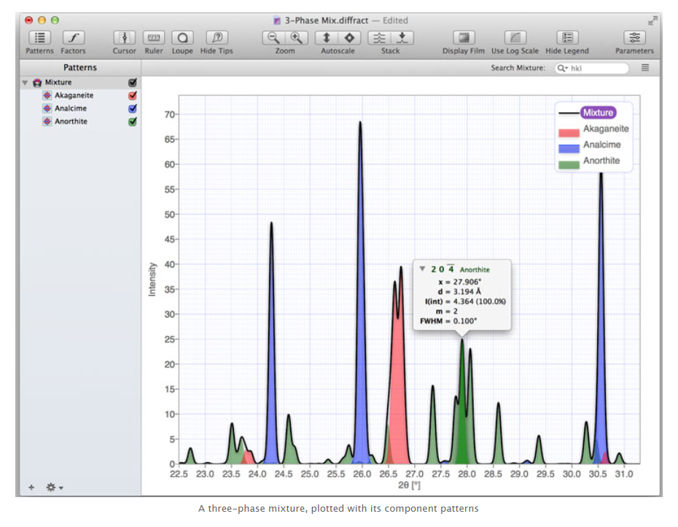
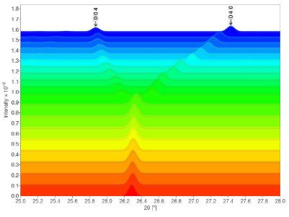
CrystalDiffract

Slide 17
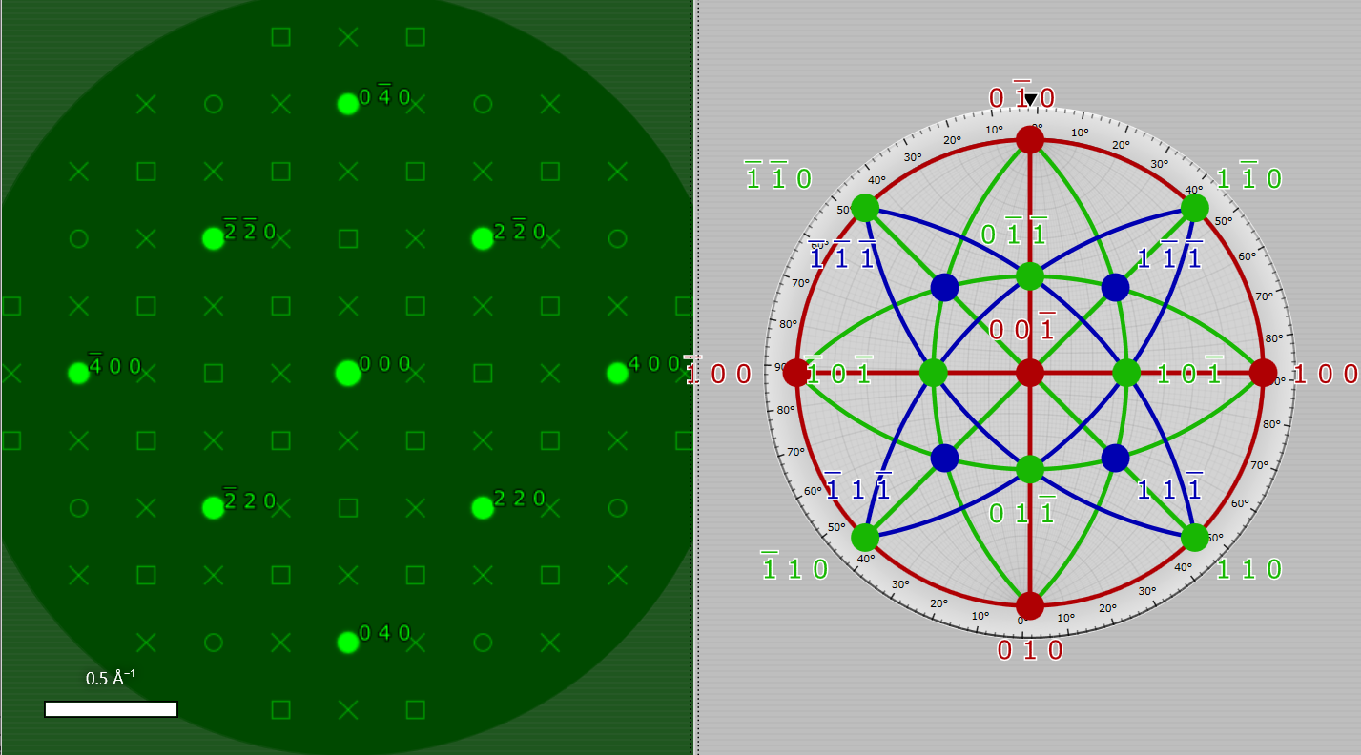
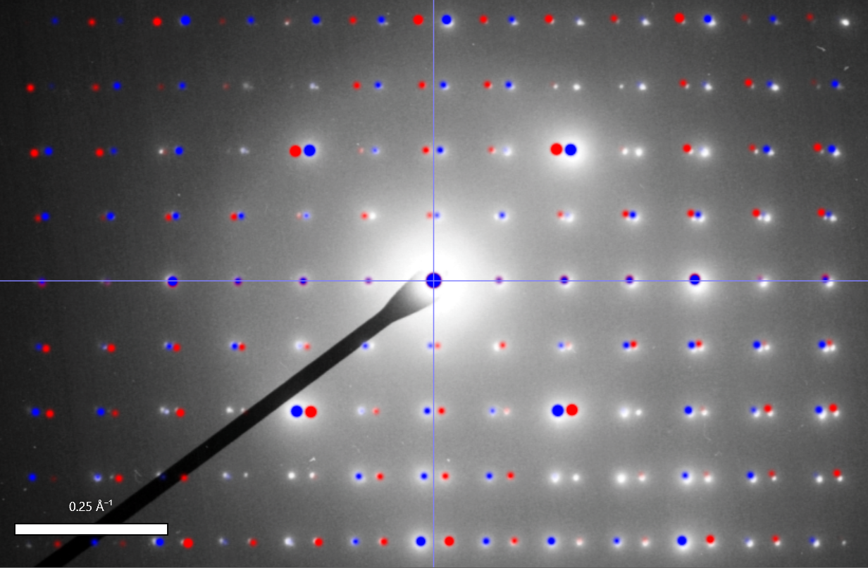
SingleCrystal

Slide 18
Extensions
Multiple structures
Epitaxial interfaces
Molecule creation/optimization
Transformations
Volumetric data visualization
Symmetry explorer
Pair-distribution outputs
IR Spectra
Vector annotations
Measuring/calibrating diffraction patterns

